Slide 1





Advanced Docker
Advanced Techniques
Distributed Applications. Clusters
DevOps
Basics
SoftUni Team
Technical Trainers
Software University
http://softuni.bg

Slide 2

Table of Contents
Advanced techniques
Volumes
Networking
Distributed Applications
Linking Methods
Docker Compose
Docker Hosts in Cluster
Components and Principles
Docker Swarm

Slide 3
Have a Question?
sli.do
#SU-DOB-M3

Slide 4
Proposed Environment Setup M2 / M3
VM1
VM2
…
C1
C2
…
C1
C2
…
C1
C2
…
C1
C2
…
Docker
Docker
Docker
CentOS
CentOS
CentOS
Docker
VirtualBox
Host OS
(Win, Linux, Mac)
Host OS
(Win, Linux, Mac)
Module #2
Modules #2 and #3

Slide 5

Quick Recap
DOB Week 2

Slide 6
DOB Week 2
Containerization
Introduction to Docker
Docker in Action
Create Our Own Images

Slide 7
Networking
Overview and Usage

Slide 8
Components
Three components
CNM
Libnetwork
Drivers
CNM
Libnetwork
Drivers
(Specifications)
(Networking logic, API, …)
(Bridge, Overlay, …)

Slide 9
Overview
CON-1
CON-2
docker host
eth0: 172.15.0.2
eth0: 10.0.0.2
veth
veth
docker0
my-bridge
eth0: 192.168.1.2

Slide 10
network connect
Purpose
Connect a container to a network
Syntax
Example
docker network connect [options] network container
# connect container to a network
docker network connect \
dob-bridge \
cont-001

Slide 11
network create
Purpose
Create a network
Syntax
Example
docker network create [options] network
# create new bridge network
docker network create -d bridge \
--subnet 10.0.0.1/24 \
dob-bridge

Slide 12
network disconnect
Purpose
Disconnect a container from a network
Syntax
Example
docker network disconnect [options] network container
# disconnect container from a network
docker network disconnect –f \
dob-bridge \
cont-001

Slide 13
network inspect
Purpose
Display detailed information on one or more networks
Syntax
Example
docker network inspect [options] network [network]
# show network details
docker network inspect dob-network

Slide 14
network ls
Purpose
List networks
Syntax
Example
docker network ls [options]
# list IDs of all networks
docker network ls -q
# list all networks that satisfy the filter
docker network ls -f driver=bridge

Slide 15
network prune
Purpose
Remove all unused networks
Syntax
Example
docker network prune [options]
# remove all unused networks without asking
docker network prune --force
# remove all network satisfying a filter
docker network prune --filter driver=bridge

Slide 16
network rm
Purpose
Remove one or more networks
Syntax
Example
docker network rm network [network]
# remove networks net-1 and net-2
docker network rm net-1 net-2

Slide 17
Volumes
Overview and Usage

Slide 18
Volume Overview
Allow for external data in containers
Two types
Data volumes
Data volume containers
Created upfront, during run or build phase (VOLUME command)
Data volumes can be shared
Data volumes persist
Data volumes are not deleted automatically

Slide 19
volume create
Purpose
Create a volume
Syntax
Example
docker volume create [options] [volume]
# create local volume test-vol
docker volume create test-vol
# create local volume lv-1 with label
docker volume create lv-1 --label mode=dev

Slide 20
volume inspect
Purpose
Display detailed information on one or more volumes
Syntax
Example
docker volume inspect [options] volume [volume]
# show details about volume test-vol
docker volume inspect test-vol

Slide 21
volume ls
Purpose
List volumes
Syntax
Example
docker volume ls [options]
# list IDs of all volumes
docker volume ls -q
# list all volumes satisfying a filter
docker volume ls --filter driver=local

Slide 22
volume prune
Purpose
Remove all unused volumes
Syntax
Example
docker volume prune [options]
# remove all unused volumes without asking
docker volume prune -f
# remove all volumes satisfying a filter
docker volume prune --filter driver=local

Slide 23
volume rm
Purpose
Remove one or more volumes
Syntax
Example
docker volume rm [options] volume [volume]
# remove volume test-vol
docker volume rm test-vol

Slide 24
Practice: Installation. Networks. Volumes
Live Demonstration in Class

Slide 25
Distributed Applications

Slide 26
Distributed Applications
Web application
User Interface
User Interface
Container
Business Logic
Business Logic
Containerized application
Container
Database Layer
Database Layer
Server
Container

Slide 27
Link Containers
By name alias
Container
#1
Container
"c-mysql"
dob-mysql
Container
"c-php"
Shared Network (docker0)
docker container run -d ... -p 8080:80 --link c-mysql:dob-mysql ...
Actual linkage / alias

Slide 28
Isolated Network
Work in an isolated environment
dob-network
Container
#1
Container
dob-mysql
Container
dob-php
Shared Network (docker0)
docker container run -d ... -p 8080:80 --net dob-network ...
Attached to the isolated network

Slide 29
Docker Compose

Slide 30
Docker Compose
Define and run multi-container Docker applications
Multiple isolated environments on a single host
Preserve volume data when containers are created
Only recreate containers that have changes
Supports variables
Use cases
Development environments
Automated testing
Single host deployments

Slide 31
Configuration
Version (up to 3.2)
version: "2.1"
services:
com-php:
build: ./php/
ports:
- 8080:80
volumes:
- "${PROJECT_ROOT}:/var/www/html:ro"
networks:
- com-network
networks:
com-network:
PROJECT_ROOT=/home/docker/w4-2-com
DB_ROOT_PASSWORD=12345
.env
Services Definition
Networks Definition
docker-compose.yml

Slide 32
docker-compose build
Purpose
Build or rebuild services
Syntax
Example
build [options] [--build-arg key=val...] [SERVICE...]
# rebuild all services
docker-compose build
# rebuild particular service with no-cache
docker-compose build --no-chache my-php

Slide 33
docker-compose down
Purpose
Stop containers and remove everything created by up
Syntax
Example
down [options]
# remove everything including all images
docker-compose down --rmi all
# remove declared named volumes and anonymous volumes
docker-compose down --volumes

Slide 34
docker-compose logs
Purpose
View output from containers
Syntax
Example
logs [options] [SERVICE...]
# view logs for all containers
docker-compose logs
# follow the log for com-php service
docker-compose logs -f com-php

Slide 35
docker-compose ps
Purpose
List containers
Syntax
Example
ps [options] [SERVICE...]
# list running containers
docker-compose ps
# display ID for a particular container
docker-compose ps -q com-php

Slide 36
docker-compose start
Purpose
Start existing containers
Syntax
Example
start [SERVICE...]
# start all containers
docker-compose start
# start particular container / service
docker-compose start com-php

Slide 37
docker-compose stop
Purpose
Stop running containers without removing them
Syntax
Example
stop [options] [SERVICE...]
# stop all containers
docker-compose stop
# stop particular container / service with timeout
docker-compose stop -t 20 com-php

Slide 38
docker-compose rm
Purpose
Remove stopped service containers
Syntax
Example
rm [options] [SERVICE...]
# remove all stopped containers
docker-compose rm
# stop all containers and remove them without asking
docker-compose rm -s -f

Slide 39
docker-compose up
Purpose
Build, (re)create, start, and attach to containers for a service
Syntax
Example
up [options] [--scale SERVICE=NUM...] [SERVICE...]
# start all containers and aggregate the output
docker-compose up
# start all containers in a daemon mode
docker-compose up -d

Slide 40
Practice: Distributed Apps. Compose
Live Demonstration in Class

Slide 41
Docker Swarm
How It Works

Slide 42
Docker Swarm
Docker engines joined in a cluster
Commands are executed by the swarm manager
There could be more than one manager, but only one is Leader
Nodes that are not managers are called workers
Both managers and workers are running containers
There are different strategies to run containers
Nodes can be physical or virtual

Slide 43
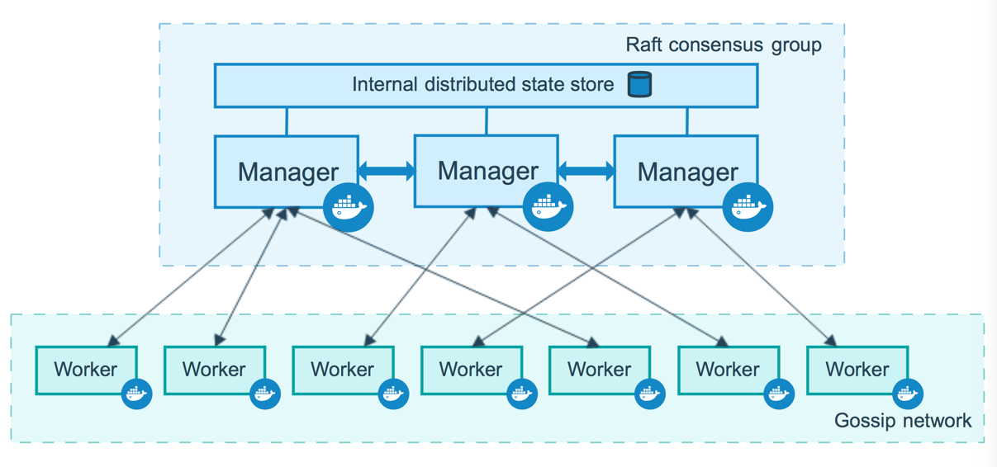
The Big Picture *
* https://docs.docker.com/engine/swarm/how-swarm-mode-works/nodes/

Slide 44
Three simple steps
Initialize cluster
docker swarm init
Join to a cluster
docker swarm join
Leave a cluster
docker swarm leave

Slide 45
Docker Swarm
Deployment options

Slide 46
Recommendations
Options
Cloud (Azure, AWS, …)
On-premise - VM, Bare-metal
Deployment Strategy (on-premise)
docker-machine
Vagrant
Today’s practice
Additional practice instructions

Slide 47
Stacks and Compose
Deployment automation

Slide 48
Tasks, Services, and Stacks
Tasks are units of work distributed to nodes
Service is an application deployed on swarm
In fact service is the definition of the tasks to execute
Replicated and global services distribution model
Stacks are groups of interrelated services
Stacks are deployed with docker-compose
Stack
Service 1
Service 2
Task 1-1
Task1-2
Task 2-1

Slide 49
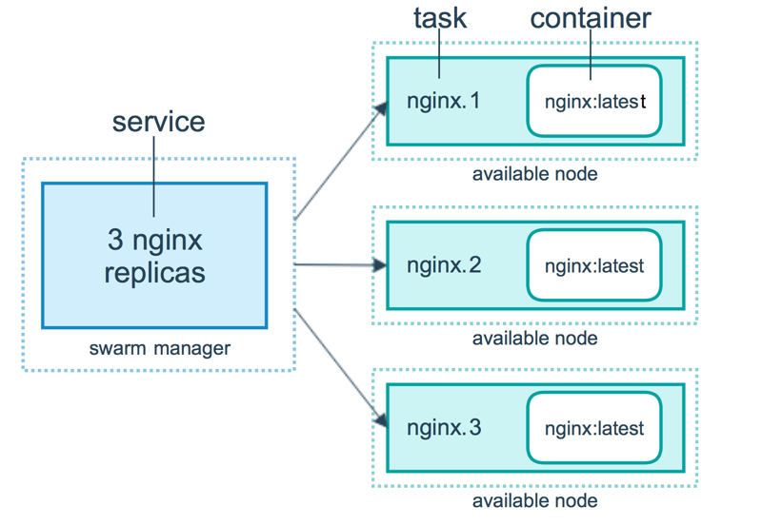
Containers, Tasks, and Services *
* https://docs.docker.com/engine/swarm/how-swarm-mode-works/services/

Slide 50
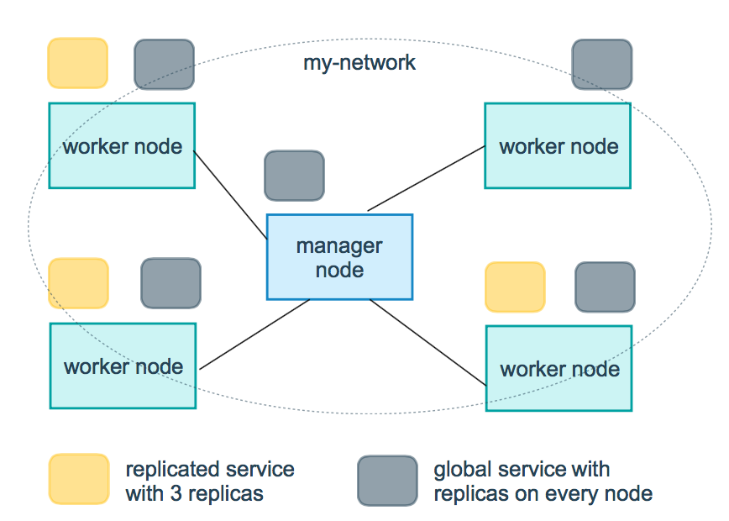
Replicated and Global Services *
* https://docs.docker.com/engine/swarm/how-swarm-mode-works/services/

Slide 51
Practice: Swarm, Services and Stacks
Live Demonstration in Class

Slide 52
Resources
Docker Client installation
https://docs.docker.com/engine/installation/linux/docker-ce/binaries
Docker Machine
https://docs.docker.com/machine
Docker Compose
https://docs.docker.com/compose
Docker Swarm
https://docs.docker.com/engine/swarm/

Slide 53
Summary
Networking - inspect, tune, add, and remove
Volumes - types, inspect and manage
Distributed applications and Docker Compose
Docker Swarm
How it works
Deployment options
Stacks and Compose

Slide 54







Advanced Docker
https://softuni.bg/courses/

Slide 55





Trainings @ Software University (SoftUni)
Software University – High-Quality Education, Profession and Job for Software Developers
softuni.bg
Software University Foundation
http://softuni.foundation/
Software University @ Facebook
facebook.com/SoftwareUniversity
Software University Forums
forum.softuni.bg

